Slide 1
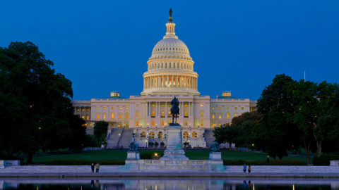
5th Grade
Washington, DC
Field Trip

Slide 2
When?: We will be leaving early morning on Monday, March 26th and returning late evening Wednesday, March 28th.

Slide 3
How much?: The total cost is $400 per person. This includes hotel stay, transportation, entry into all events, and food. You can make four separate payments of $100. You may also pay for the trip in full by November 1st. Payment dates are as follows:
October 1st - 15th *must pay to reserve spot
November 1st - 15th
January 1st - 15th
February 1st - 15th
* It is important to remember that NO refunds will be issued. This includes emergencies, cancellations, and loss of trip due to behavior.

Slide 4
Chaperones?: We would love for as many parents/guardians to come as possible! Please consider joining your scholar on this hands-on learning experience!
Cost for chaperones is also $400. You can pay an additional fee for a separate room.
What are we going to do?
learn about our nation’s history
Visit the Smithsonian Museums
View monuments
Attend the National Cemetery
Visit the National Zoo

Slide 5
Day 1: Monday, March 26th, 2018
6:00am Buses arrive at school, begin loading
6:30am Depart for Washington, DC
12:30pm Lunch: Eat bag lunch (brought from home) before entering Washington
2:00pm Smithsonian Museums:
Natural History Museum
Museum of American History
6:00pm Dinner: Buffet Dinner Columbia Island Marina Restaurant (included)
7:30pm Visit the Pentagon 9/11 Memorial
8:30pm Check into hotel: Homewood Suites by Hilton Dulles North,
44620 Waxpool Rd, Ashburn VA 20147

Slide 6
Day 2: Tuesday, March 27th, 2018
6:00am Continental breakfast in hotel dining room; board buses at 7:30am
8:30am Visit the MLK, FDR and Jefferson Memorials
10:30am Smithsonian Museums:
National Air & Space Museum (lunch included)
African-American Museum of History and Culture
3:00pm Visit the Washington Zoo
5:00pm Dinner: Reagan Building food courts (meal voucher included)
6:30pm Visit the WWII, Lincoln, Vietnam Veterans, and Korean Memorials
8:30pm Return to hotel

Slide 7
Day 3: Wednesday, March 28th, 2018
6:00am Continental breakfast in hotel dining room; board buses at 7:30am
8:15am Guided tour of US Capitol (requested)
View Library of Congress and Supreme Court Buildings near Capitol
10:00am Group photo in front of the White House
11:00am Box lunches from Harriet’s Restaurant: 436 11th St., NW (included)
12:00am Guided tour of Arlington National Cemetery
2:00pm Depart Washington; fast food dinner in route ($5 cash included)
9:00pm Approximate arrival time at school

Slide 8
FAQ?:
Who will be my child’s chaperone?
Who will my child room with?
My child takes medicine, how will it be administered?
When will they arrive back to the hotel?
Safety at the hotel?
Can my child call home?

